Slide 1
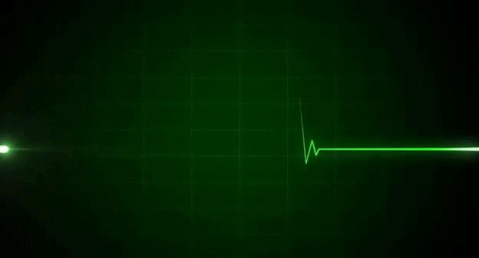
Heart Rate Monitoring
(PPG)

Slide 2



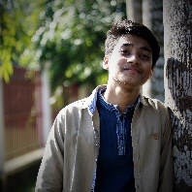


GROUP MEMBERS
Khondoker Al Mamun | 1606034
Md. Nasim Afroj Taj | 1606037
Sakib Chowdhury | 1606044
Md. Sultan Mahmud | 1606050
Md. Akibul Hasan Mazumder | 1606051
Samit Hasan | 1606056

Slide 3
PROJECT OBJECTIVE
To analyze Heart Beat from a given dataset.
To eliminate noise from the data (filtering)
Plot filtered heartbeat data
Determine heart beat

Slide 4
METHODOLOGY
Take the data set provided as input
Design a Band Pass Filter with cutoff frequencies at 30 to 200 bpm
Filter the given data with the BPF
Plot the filtered output
Determine the heart rate and comment on it
Additionally determine Heart Rate by ACF for crosscheck purpose
1 bpm = frequency (in HERTZ)*60

Slide 5
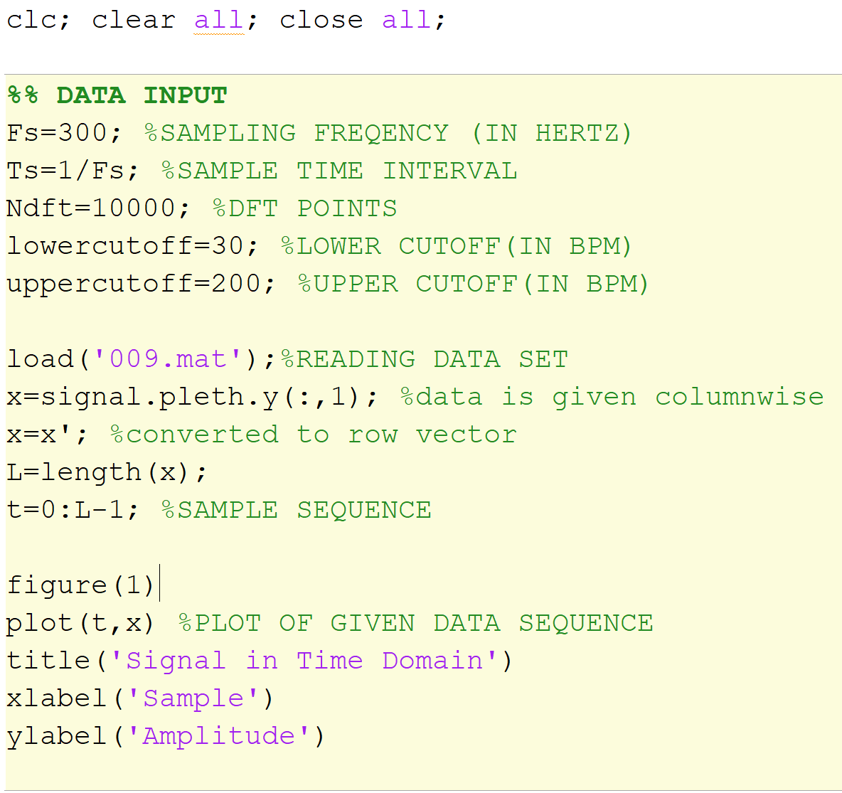
PROCEDURE
At first We took the data set 009.mat as input and plotted as it was
We took 30 bpm and 200 bpm as the cutoffs of BPF as we’re suggested

Slide 6
Unfiltered plot of 009.mat
(in time domain)

Slide 7
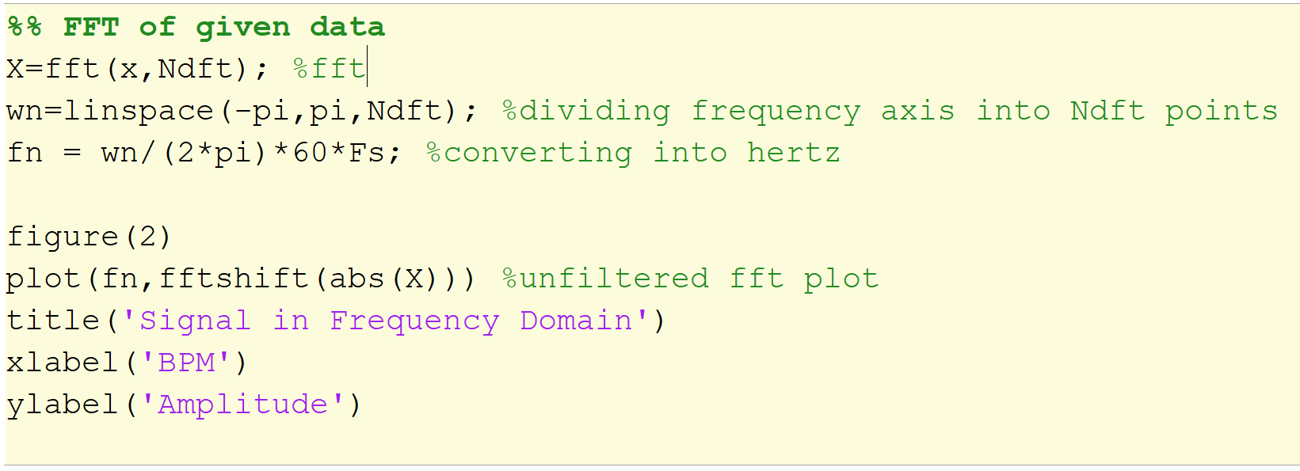
Unfiltered fft plotting of given data (In frequency domain)

Slide 8
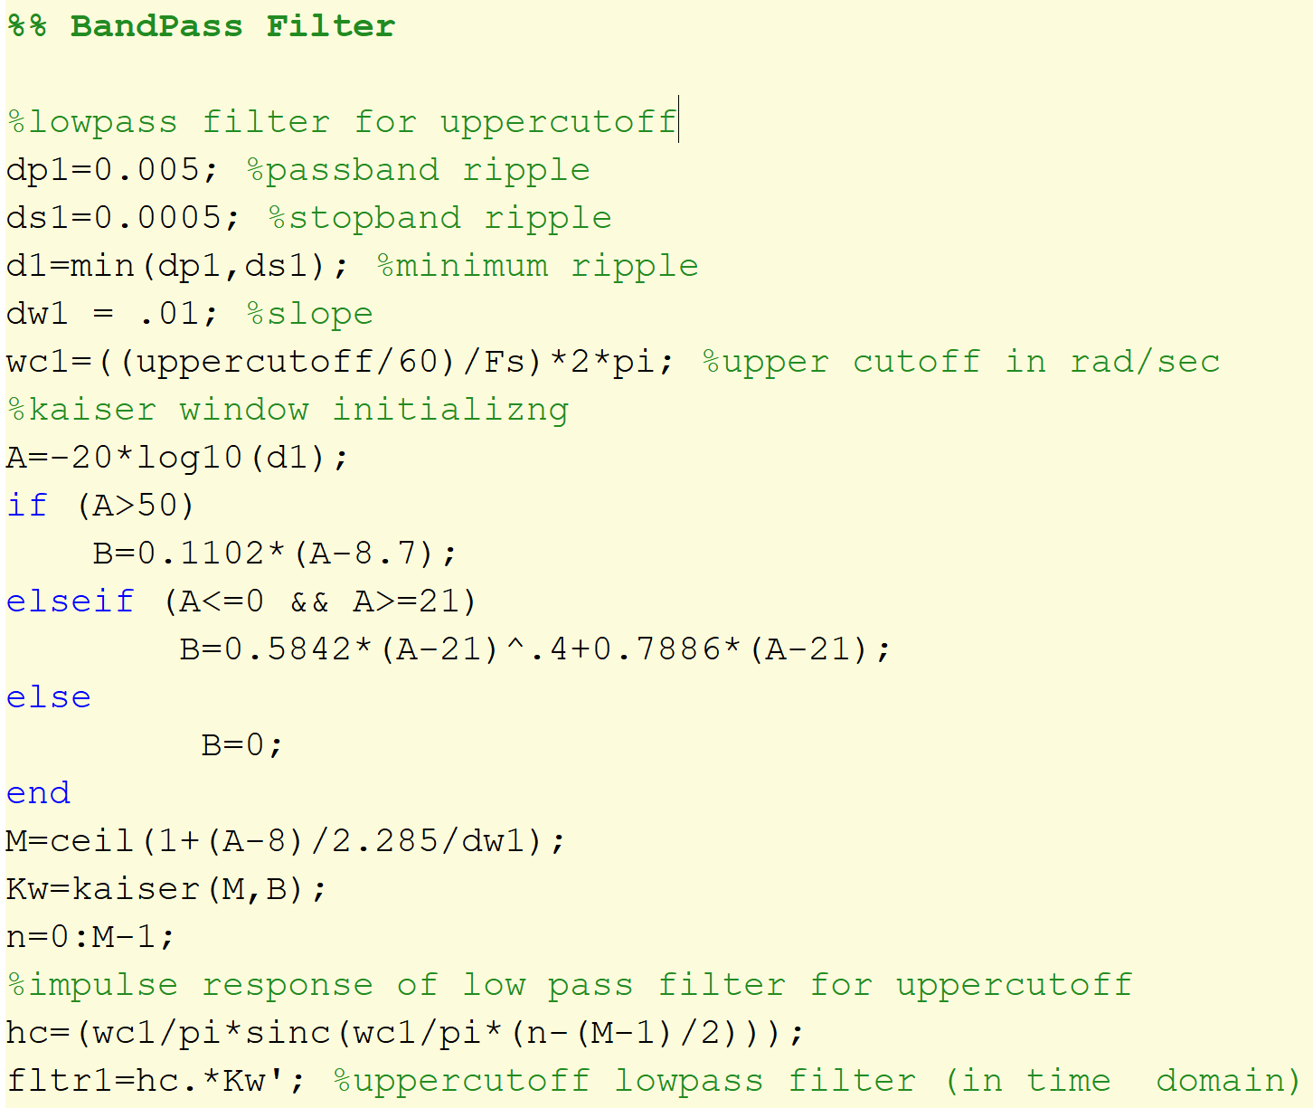
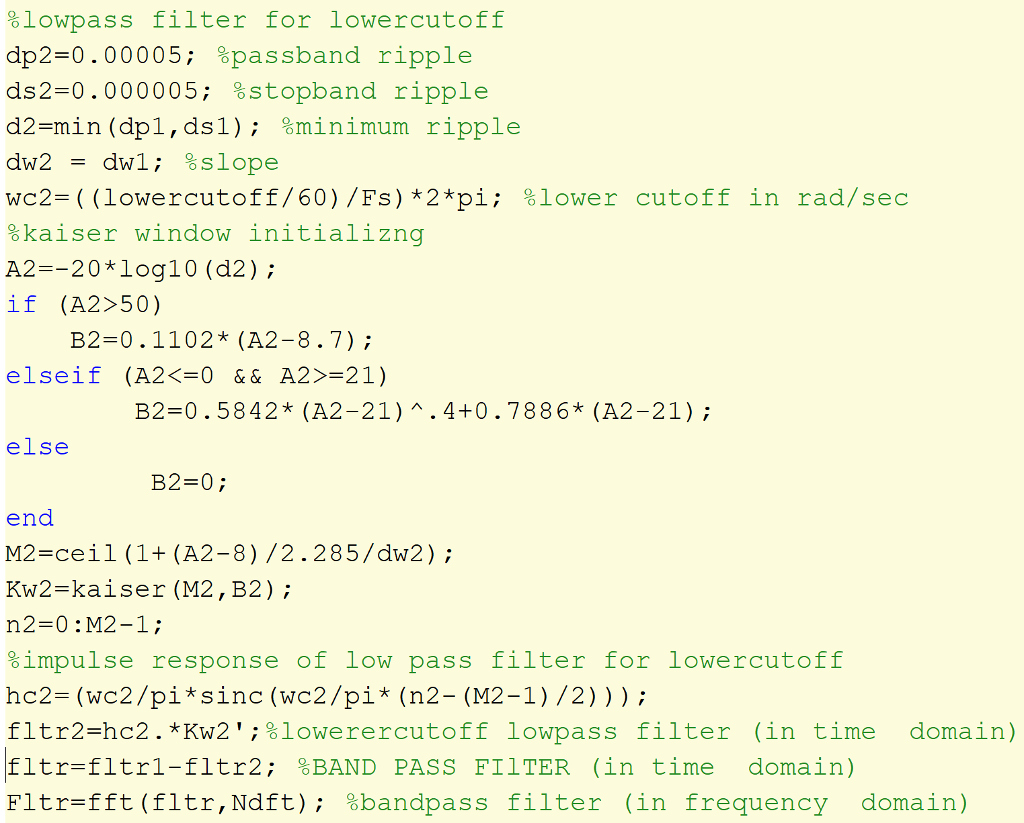
We designed a bandpass filter using two low pass filters with respective cutoffs at 30 and 200 bpm…
[controls of both LPF are kept flexible]
BPF = LPF₂₀₀ - LPF₃₀

Slide 9
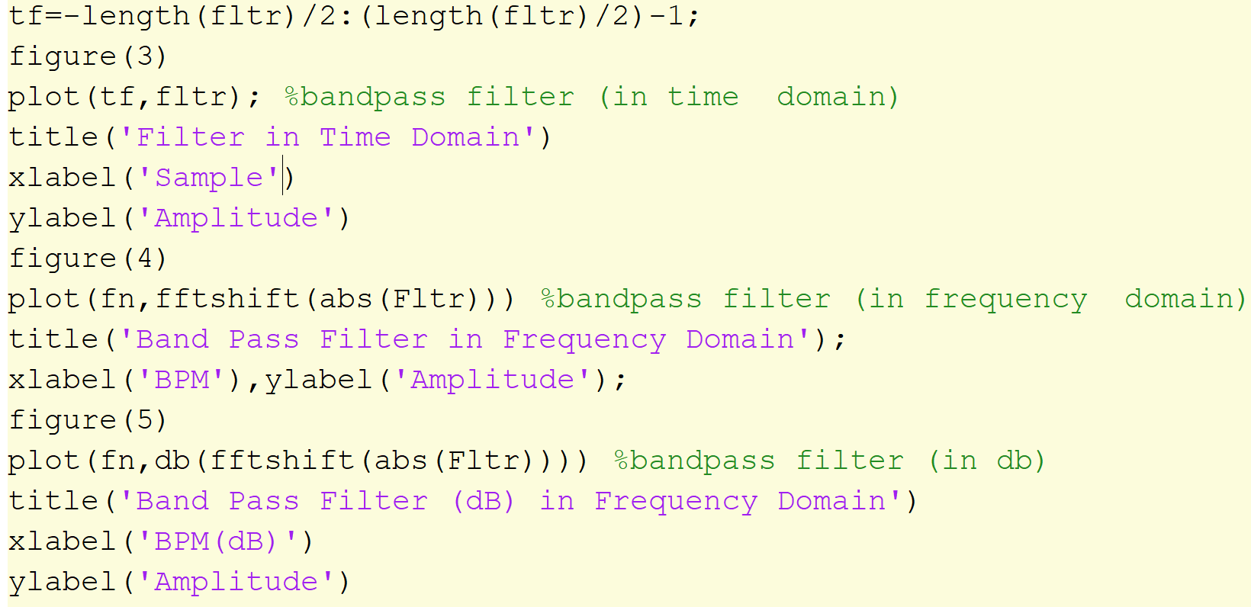
Designed BPF response in time domain
Filter response plotting
BPF_{dB} response in frequency domain
BPF response in frequency domain

Slide 10
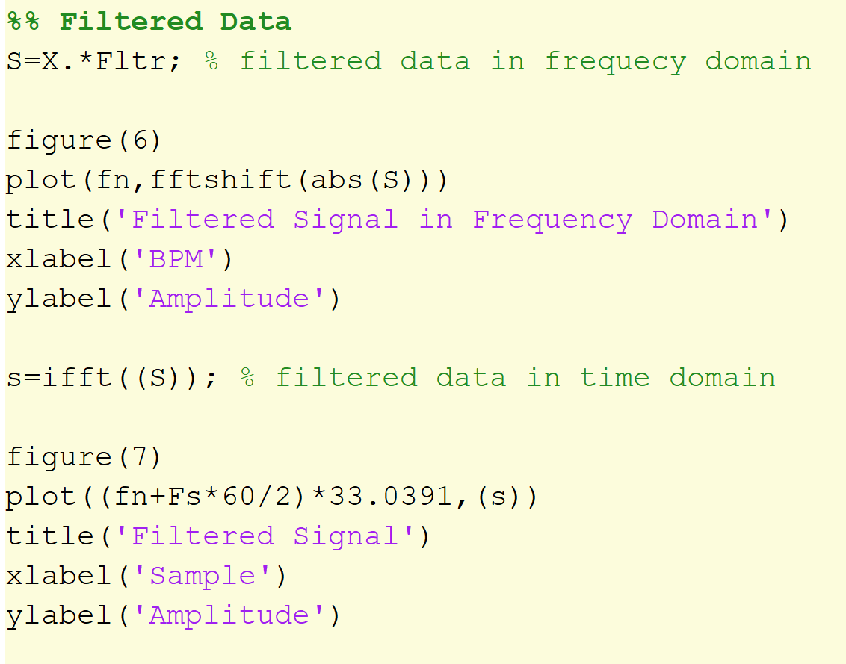
Then we filtered the data set 009.mat with the BPF we designed and plotted filtered output in frequency and time domain
Filtered fft plotting of given data
(In frequency domain)

Slide 11
Filtered plot of 009.mat
(in time domain)

Slide 12
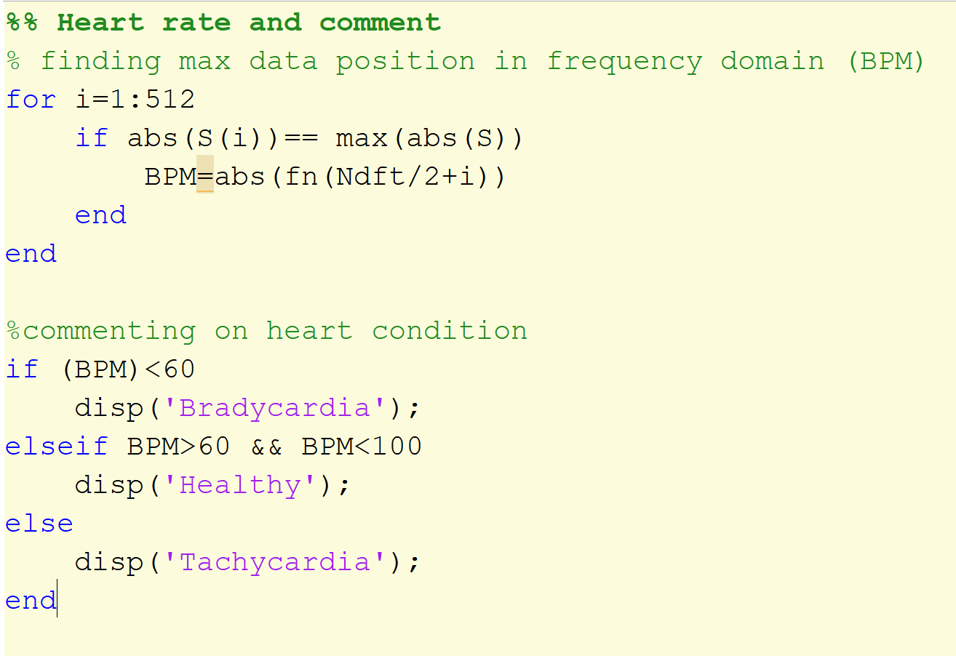
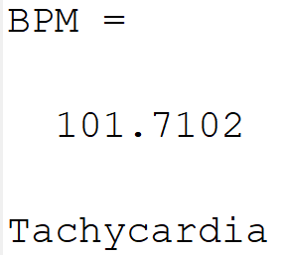
Then we determined the Heart rate in BPM and commented on it.

Slide 13
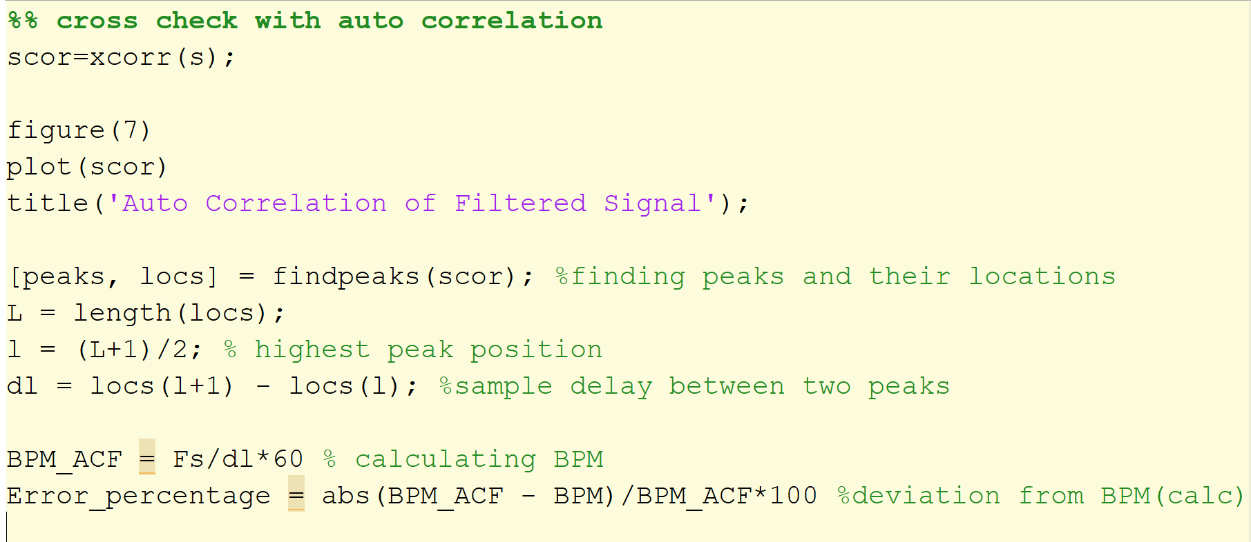
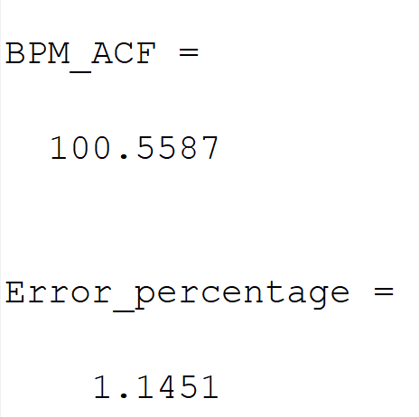
Additionally we found the ACF and crosschecked our calculated data

Slide 14
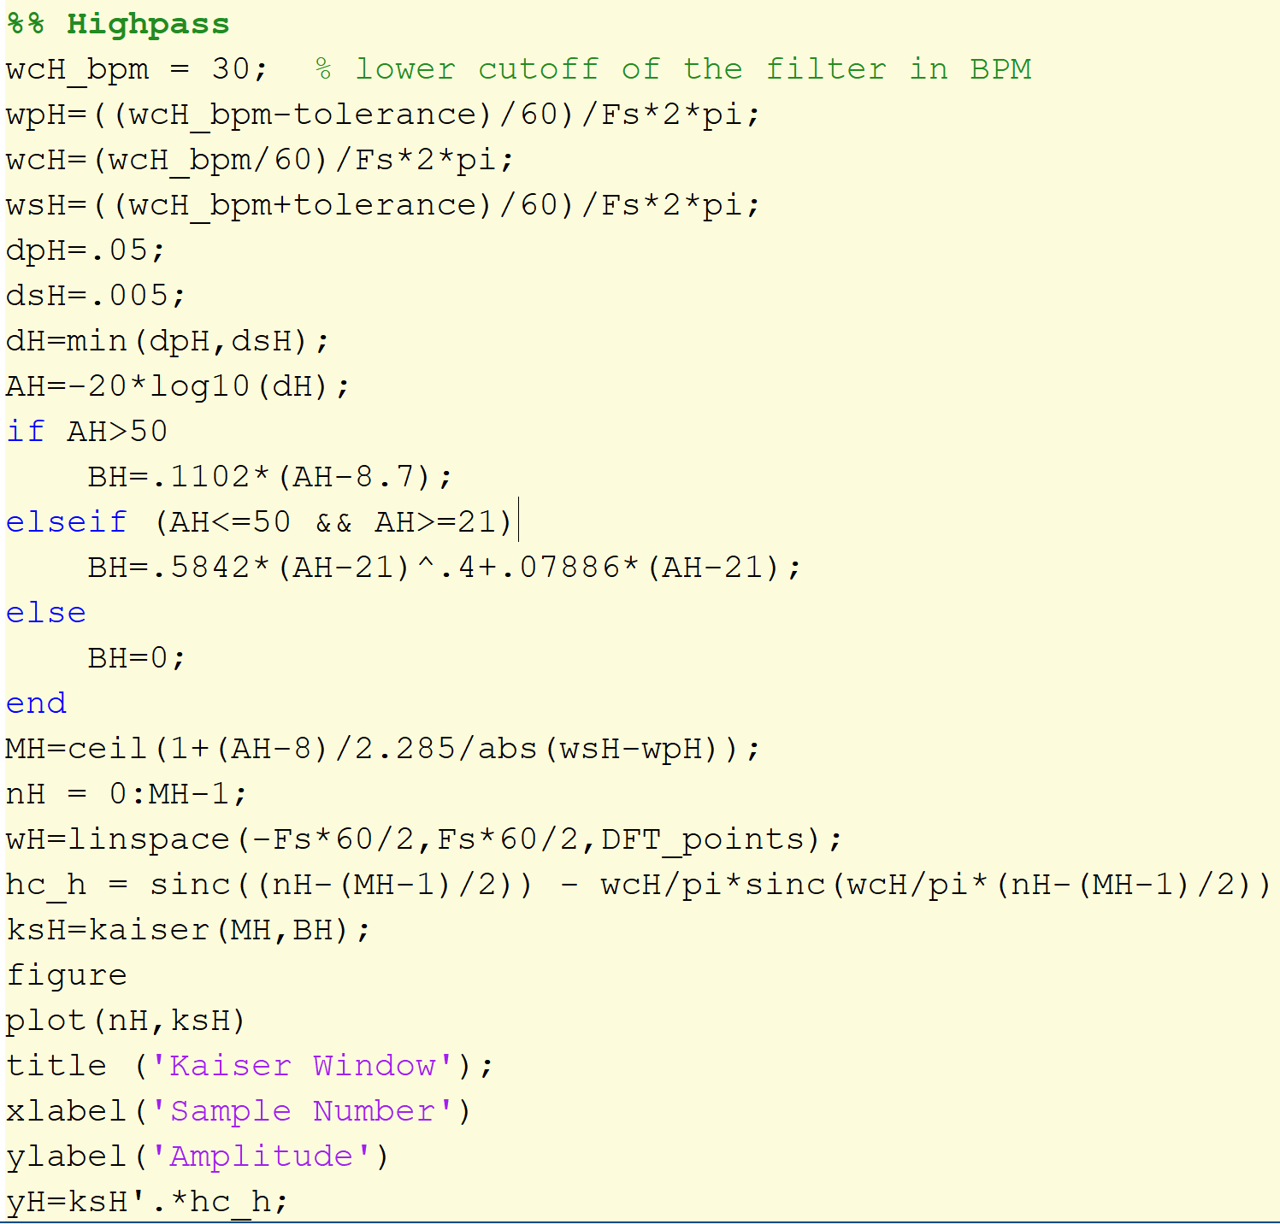
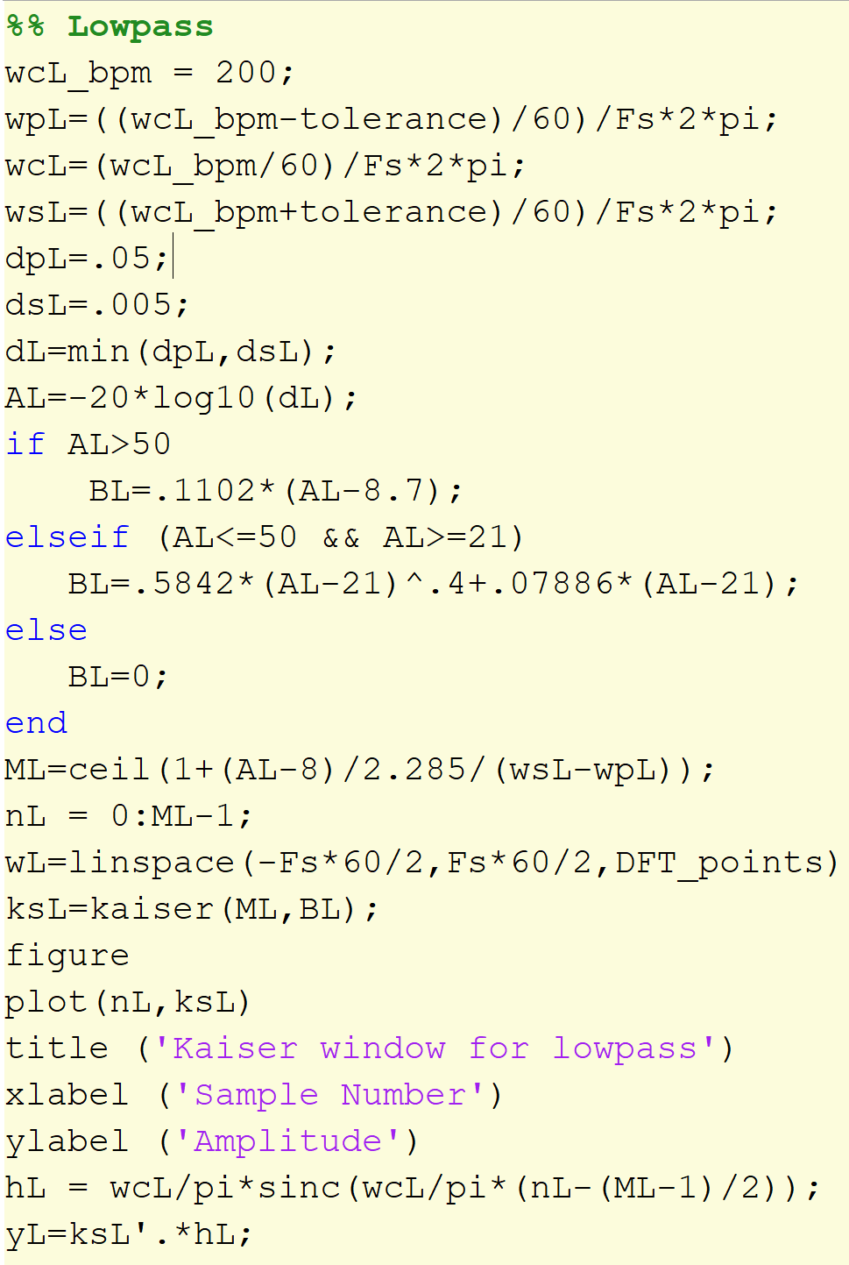

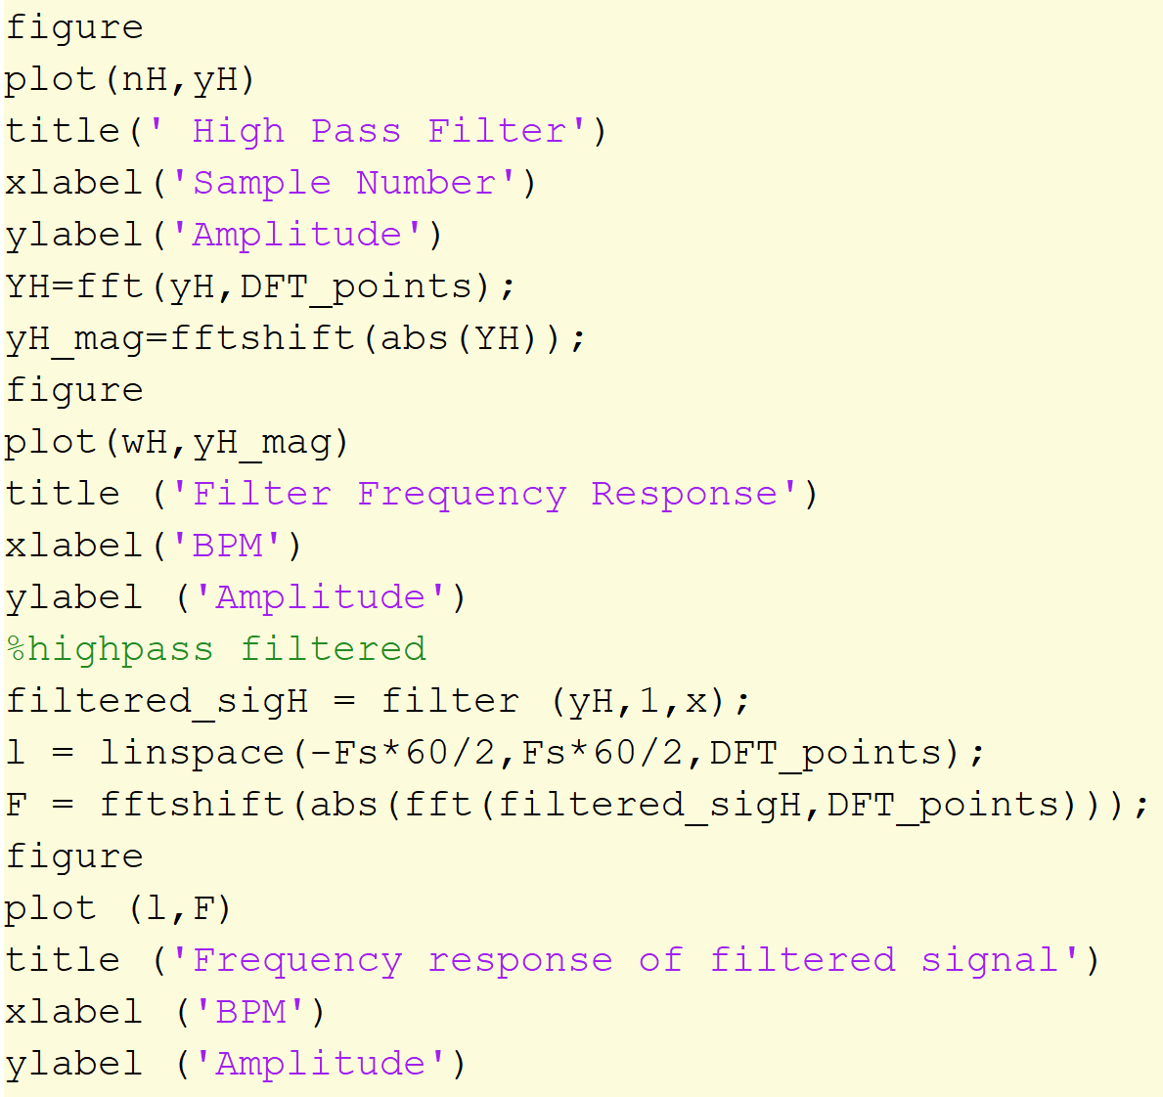
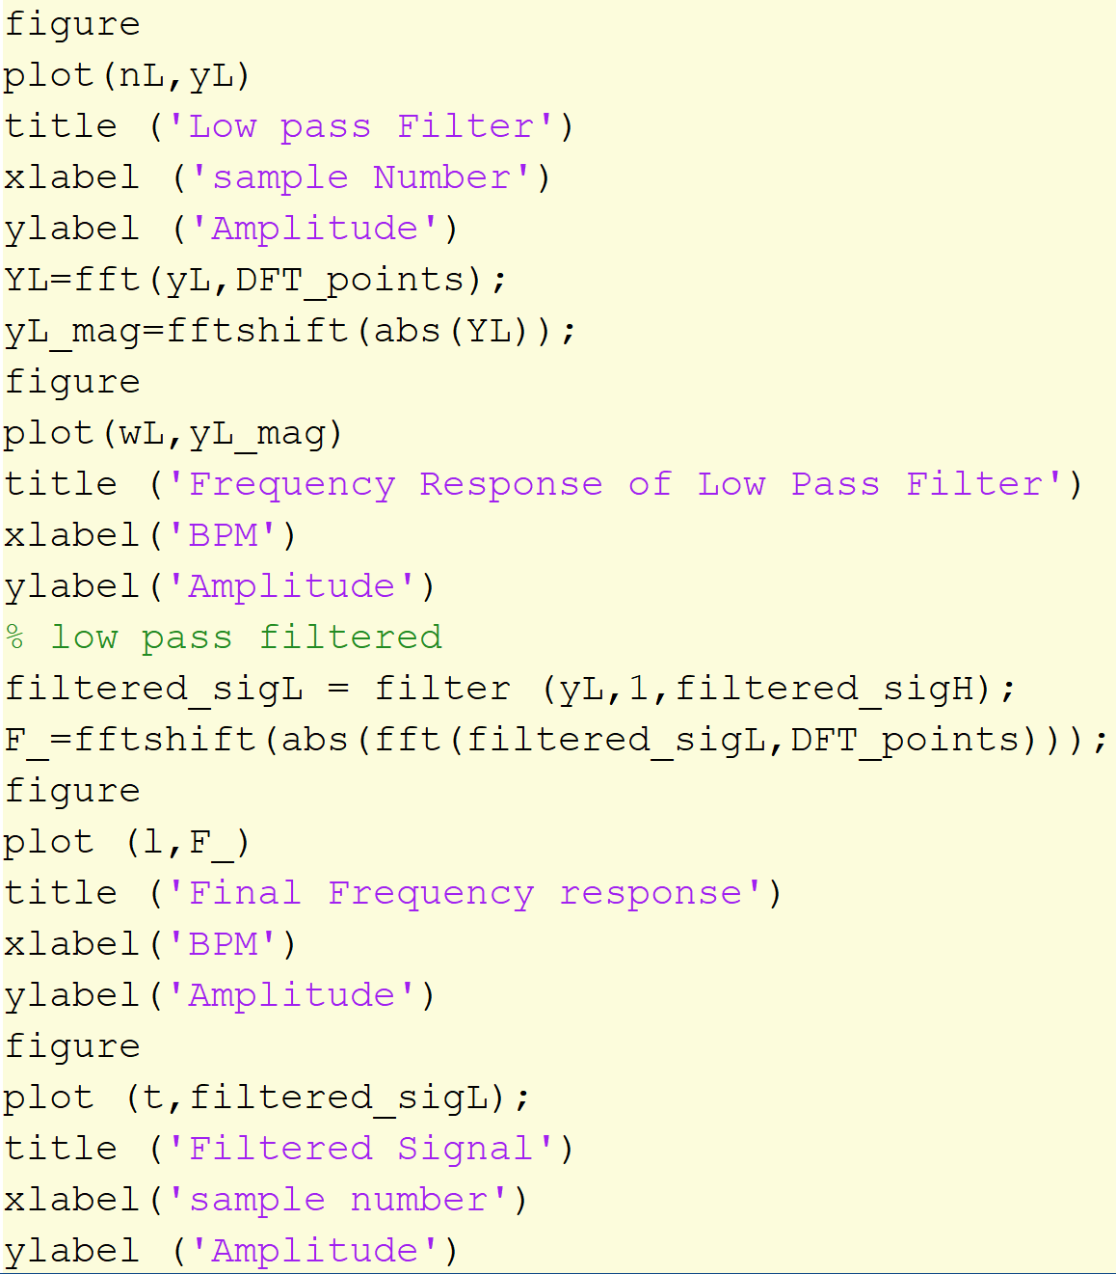
We used another technique of designing a BPF and got the same results
Here we first filtered the input signal with a HPF with cutoff at 30bpm. Then we filtered the output signal with a LPF with cutoff at 200bpm.
Our target BPF was achieved
We ran this program for some other inputs. The results are shown on the nesxt slides

Slide 15
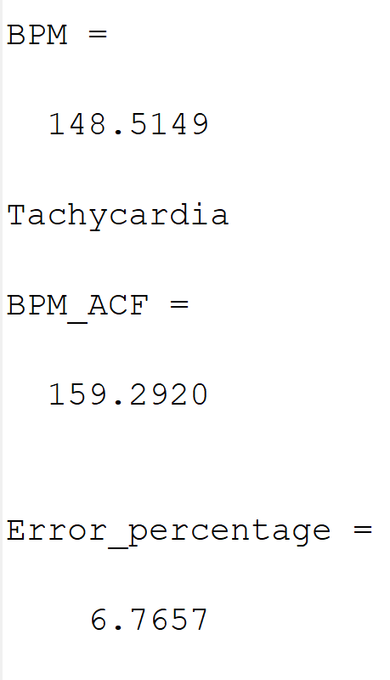
0023_8min.mat

Slide 16
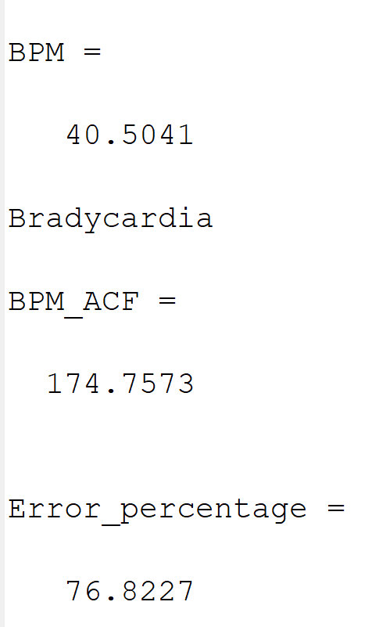
6.mat
We got this huge error as the sampling frequency was not provided and so we used an arbitrary one
[300Hz]

Slide 17
Discussion
We choose Kaiser window for its efficiency and better controlling opportunity.
(Filters using remez and remezord algorithm may have given more control.)
For some data sets the Sampling Frequency was absent. So, we couldn’t get desired output using an arbitrary sampling rate.

